Slide 1
eProcurement ontology 8th Working group meeting eSubmission and eEvaluation
Luxembourg, 2019-02-12+13

Slide 2
Table of Contents
The road-map
Work done : Where we are
Challenges ahead:
eEvaluation
eSubmission

Slide 3
The road-map
Phase 0
eAccess
eNotification
Phase 2
eSubmission
eEvaluation
Phase 3
eAwarding
eContract
Phase 4
Contracts Registry
eOrdering
Phase 5
eFulfilment
Glossary
Phase 1
eCatalogue
eRequest
eInvoicing

Slide 4
Work done (1): Where we are
Phase 0
eAccess
eNotification
Phase 2
eSubmission
eEvaluation
Phase 3
eAwarding
eContract
Phase 4
Contracts Registry
eOrdering
Phase 5
eFulfilment
Glossary
Phase 1
eCatalogue
eRequest
eInvoicing
(We are here)

Slide 5
Work done: results
Phase 0 (Glossary):
Definitions provided for the Ontology classes, aligned to the ePO Glossary
Definition of the Class properties (in the Enterprise Architecture Project file)
Phase 1 (eNotification and eAccess)
Revision of the previous version (2.0.0)
Update of the models, terms and definitions based on analysis of evolution eForms
While analysing eNotification and eAccess we identify and include in the model concepts from other phases, but we do not develop them in detail.
The development of the model is iteratively being improved wiih each phase:
The analysis of the rest of phases will impact, on the work done in the previous phases.
The more initiatives (eForms, ESPD, ISA2, UBL, other) and persons intervene the more opportunities to improve the ontology we have.

Slide 6
eEvaluation
(day 1, 13th Feb.)

Slide 7
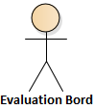
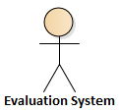
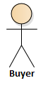

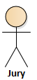
eEvaluation, objective: actors, data and business rules
Evaluation Terms
Award criteria
Exclusion Grounds & Selection Criteria
Evaluation Result
eNotification
eAccess
eSubmission
eEvaluation
eNotification
eContract
PIN
CN
Procurement Documents
CAN
ESPD
Request
Economic operator
t0
(Procedure life-cycle)

Slide 8
Day 1 (12th Feb.)
Analysis of eEvaluation
Data elements and aspects identified in eNotification related to eEvaluation
Procurement Terms
Procurement Criteria
Evaluation Result

Slide 9
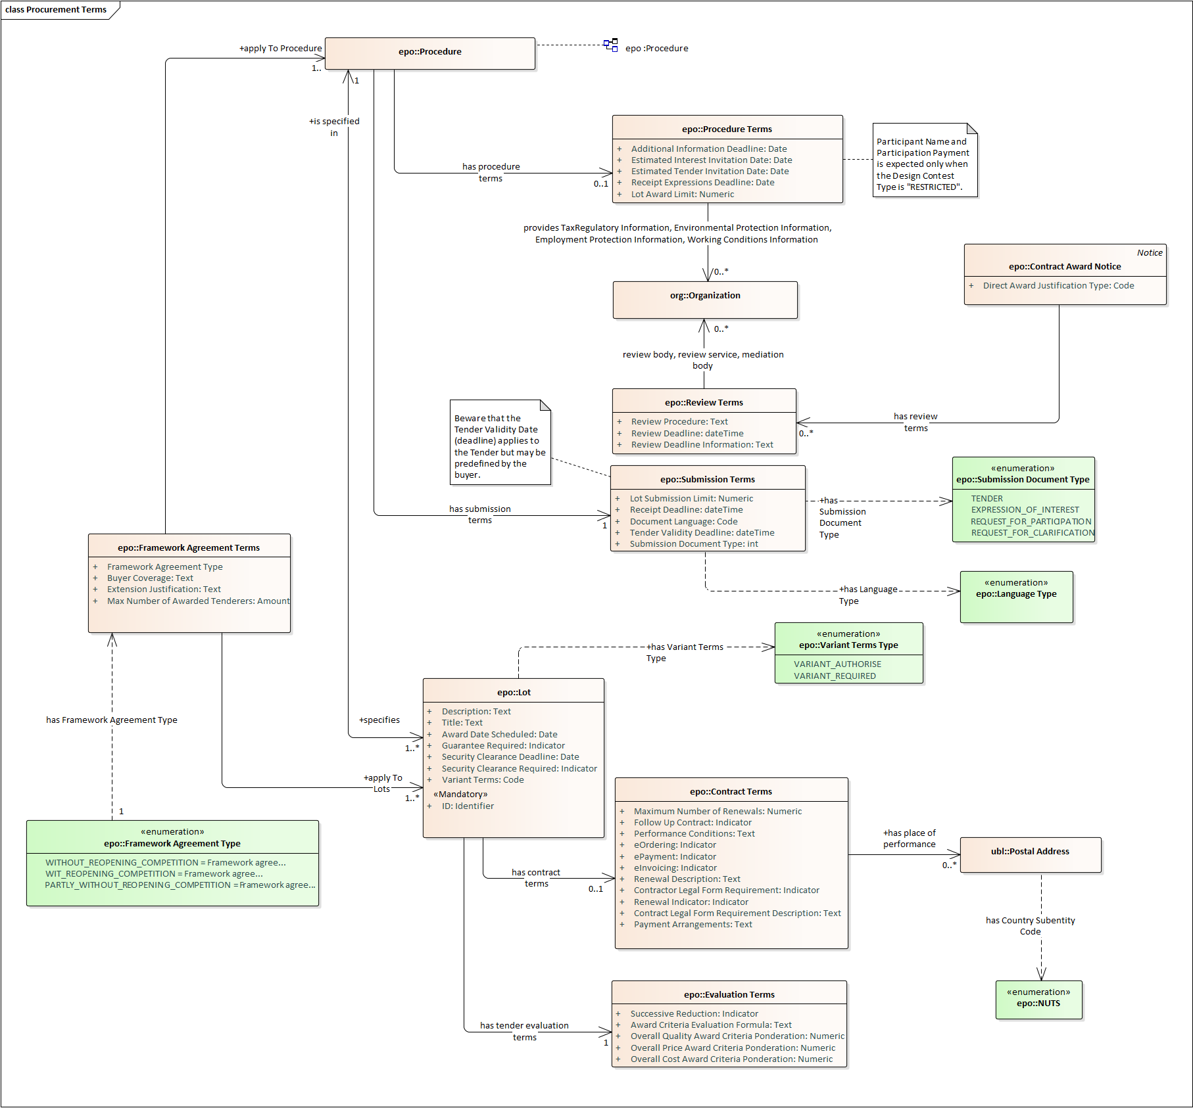
eEvaluation: Procurement Terms
All Procedures have at least one Lot

Slide 10
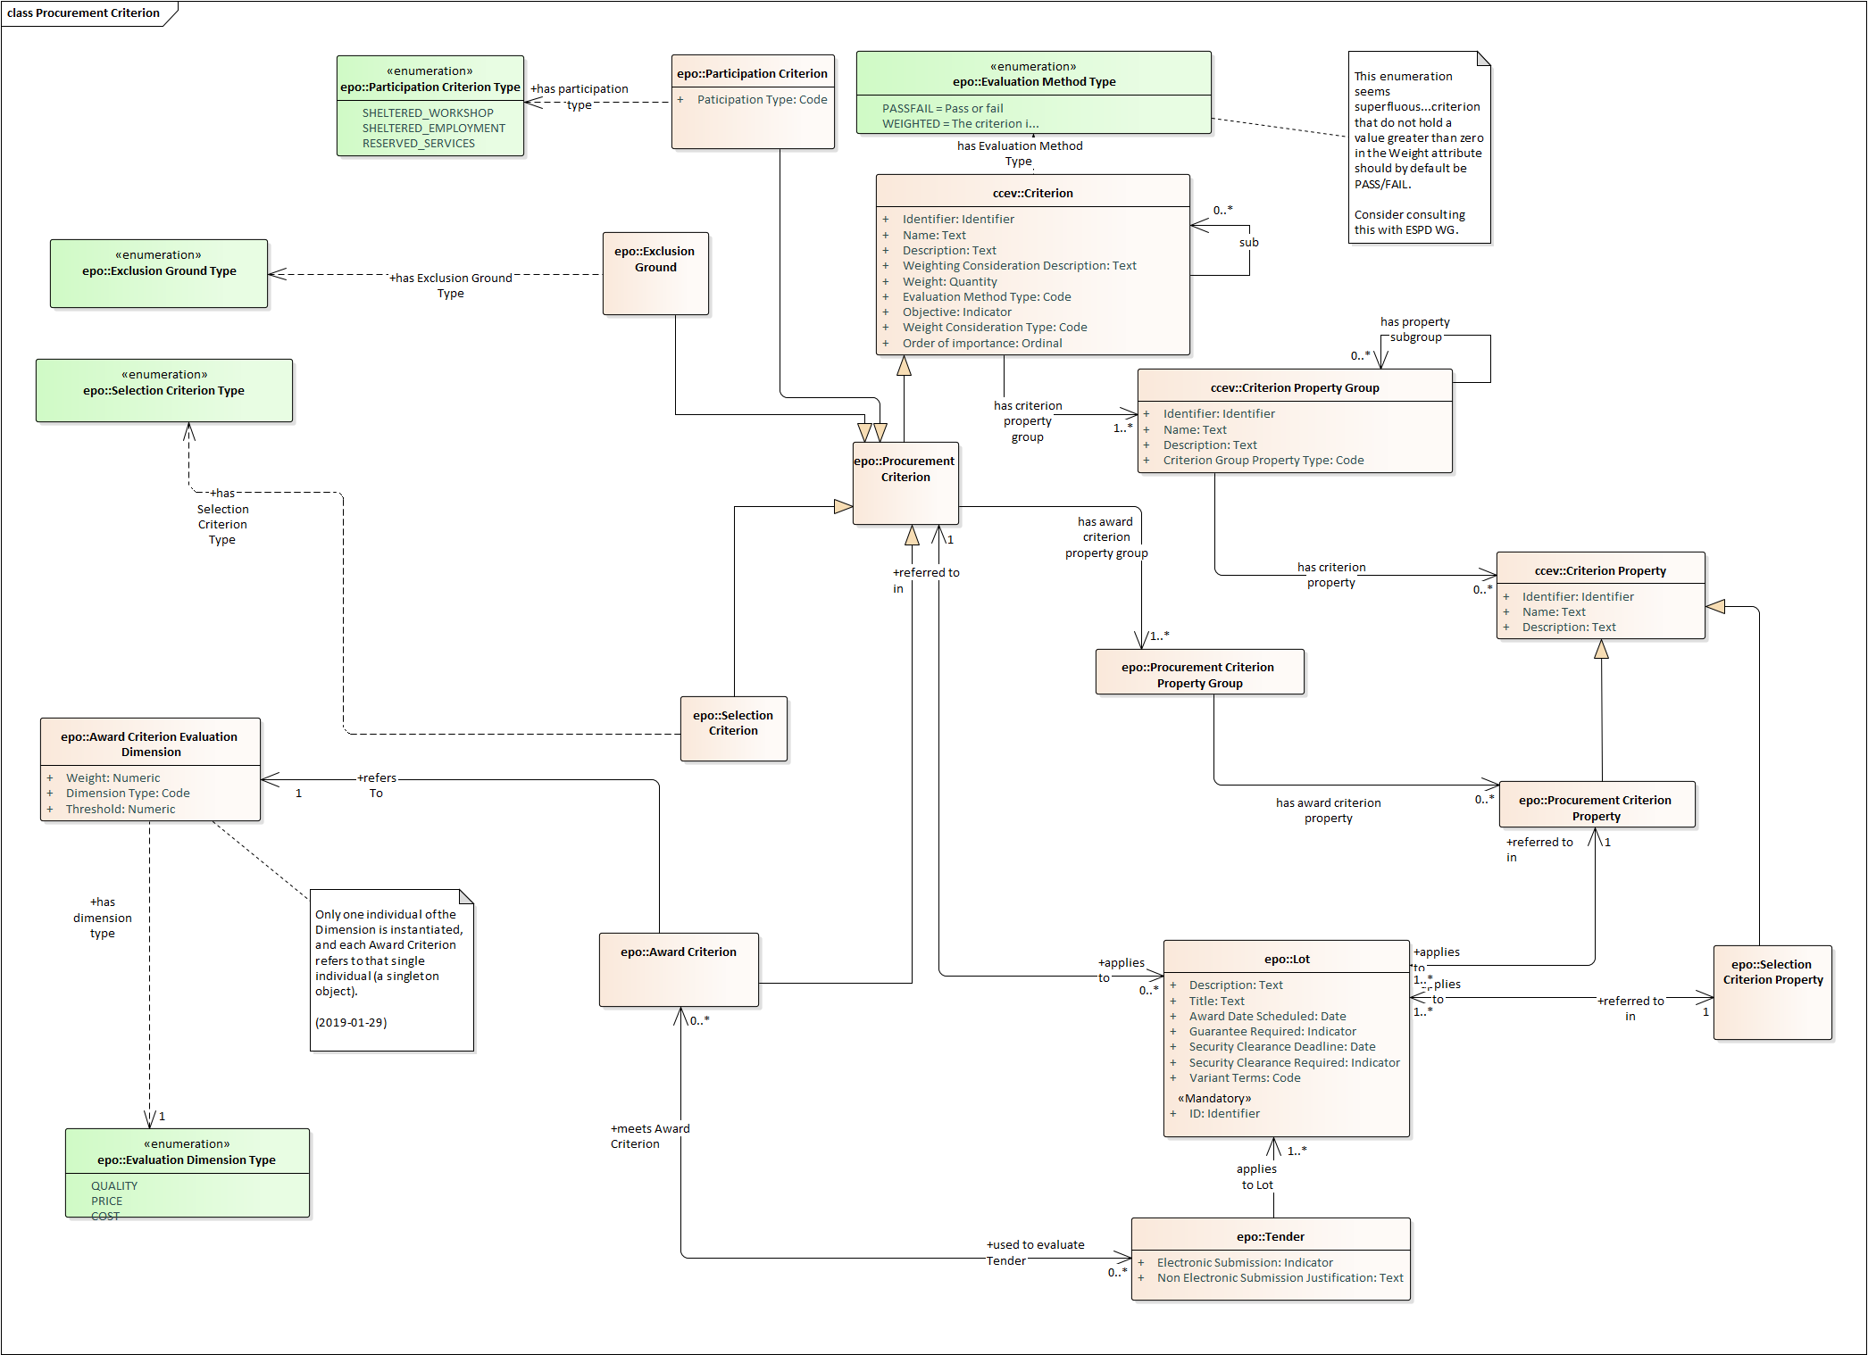
eEvaluation: Procurement Criteria
ESPD Request
Award Criteria

Slide 11
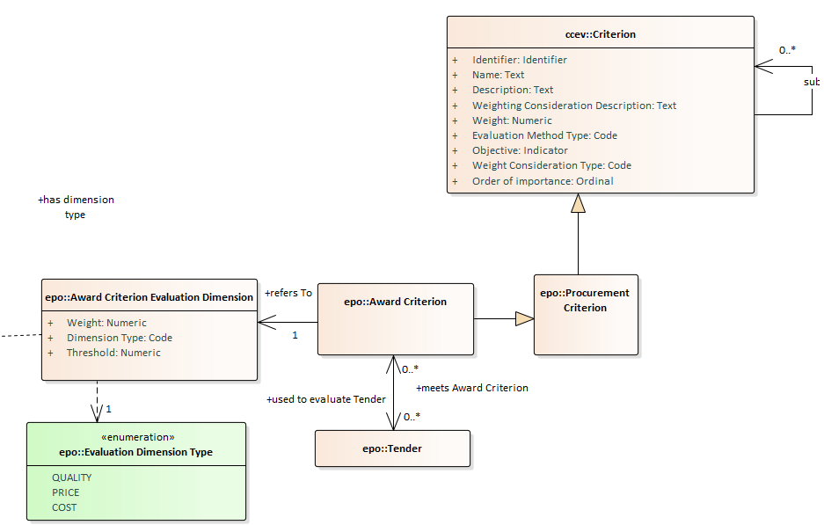
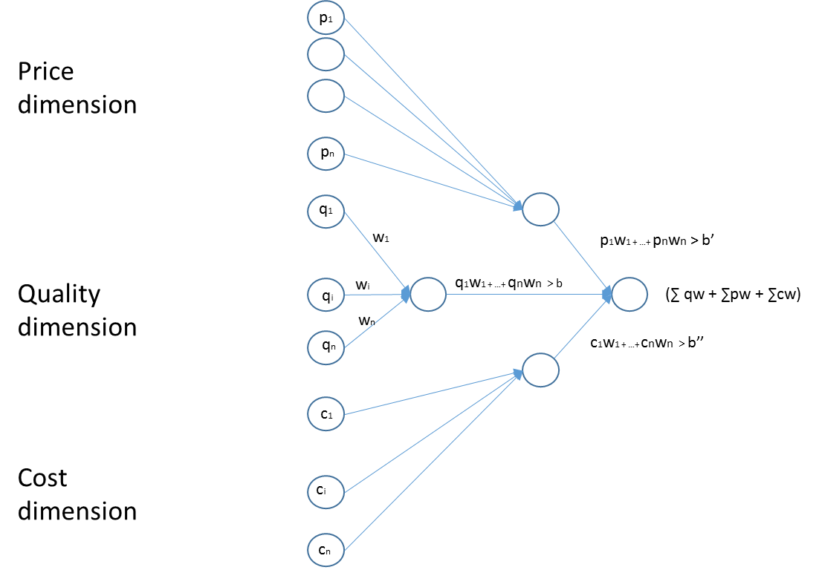
eEvaluation: Procurement Criteria

Slide 12
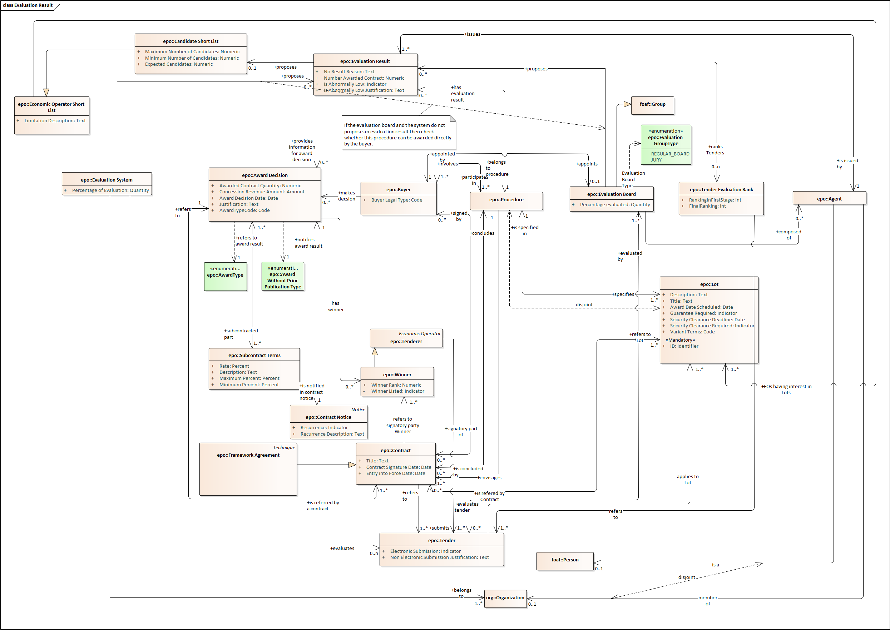
eEvaluation: Evaluation Result

Slide 13
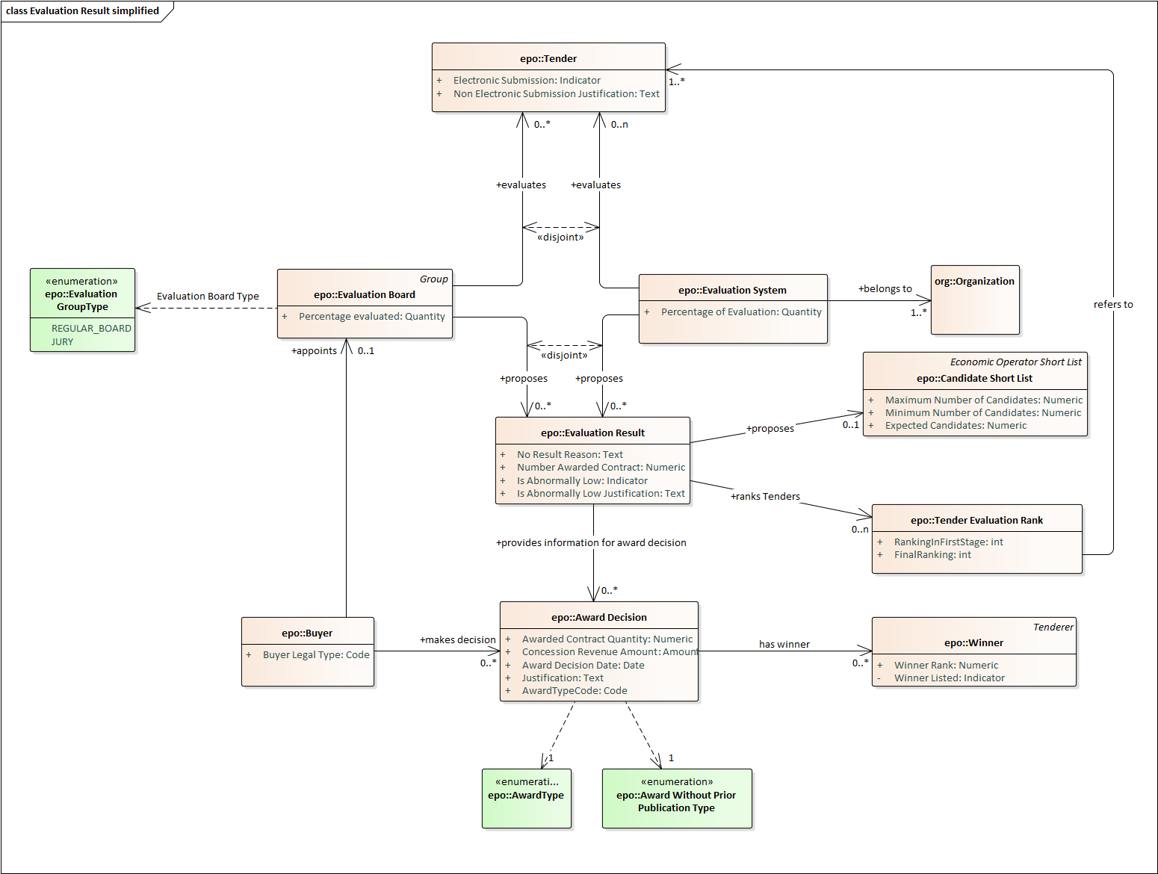
eEvaluation: Evaluation Result (simplified)

Slide 14
eEvaluation: challenges
Topics analysed, challenges faced:
Actors that may propose evaluation results identified:
Evaluation Board (regular board and jury)
Evaluation System
Entities and properties:
Multi-staged procedures, information requirement needs identified,
Award criteria → The need for weighted criteria and dimensions
Techniques and instruments → human and automated evaluation
EO Short List (SL), Candidate SL & Tender evaluation Rank → differences
Rules identified:
The board proposes and the buyer makes decision, except when
The board is a jury with binding capacity
Disjointness bewteen price and cost dimensions?

Slide 15
eSubmission
(day 2, 13th Feb.)

Slide 16
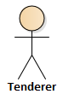
eSubmission, objective: actors, data and business rules
Evaluation Terms
Award criteria
Exclusion Grounds & Selection Criteria
Evaluation Result
eNotification
eAccess
eSubmission
eEvaluation
eNotification
eContract
PIN
CN
Procurement Documents
Procurement Documents
ESPD
Request
ESPD
Response
Economic operator
t0
(Procedure life-cycle

Slide 17
Analysis of eSubmission
Data elements and aspects identified related to eSubmission
SubmissionTerms
Access Tool
Tender

Slide 18
eEvaluation: Procurement Terms
Submission Terms

Slide 19
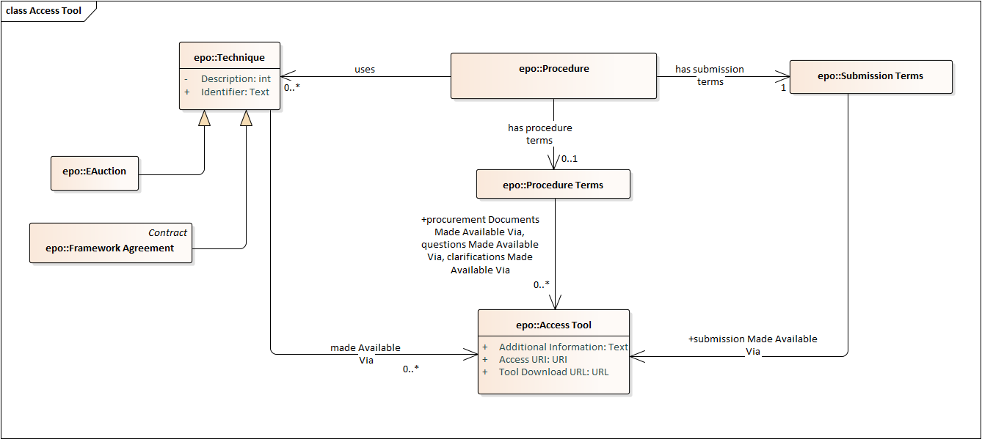
eSubmission: Access Tool

Slide 20
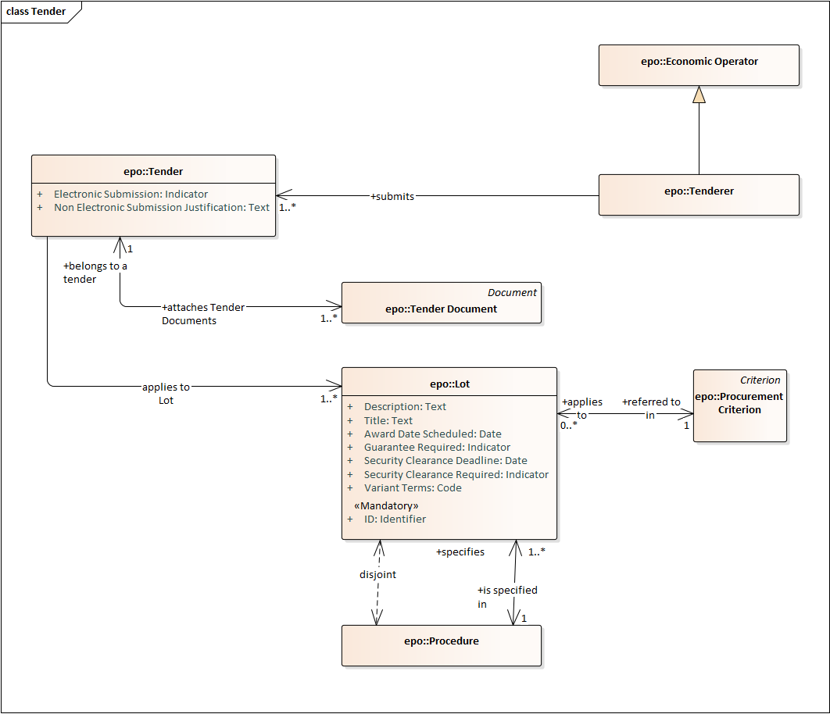
eSubmission: Tender

Slide 21
eSubmission: challenges
Elements identified, challenges faced at eNotification analysis time:
Actors involved in the eSubmission:
eTendering System (Access Tool)
Tenderer
Entities and properties:
What is in the Tender? (e.g. ESPD Response)
Who are the actors, apart from the e-Tendering System and the Tenderer?
Special information requirements, e.g. Tender hash? (where, when, how → rules, …)
Rules:
Opening of the tenders
Security and confidentiality of the tenders
Law-enforcement in general
Other…

